Slide 1


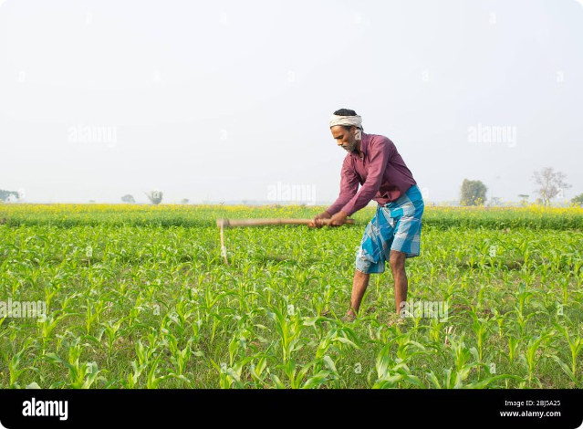
Crop Production in India: A Deep Dive
India's agriculture sector is a cornerstone of its economy, employing a significant portion of the workforce and contributing significantly to the nation's food security. This presentation will delve into the intricate world of crop production in India, examining key trends, regional variations, and challenges faced by the industry.
T
by Trideep Saha

Slide 2

The Evolving Landscape of Agriculture
Digital Transformation
Supply Chain Optimization
Climate Change Adaptation
Smart farming technologies, such as precision agriculture, are becoming increasingly prevalent, offering enhanced efficiency and resource management.
The emergence of online platforms for connecting farmers with buyers is streamlining the supply chain, reducing waste and improving market access.
Farmers are adapting to changing climate patterns by adopting drought-resistant crops and sustainable farming practices.

Slide 3

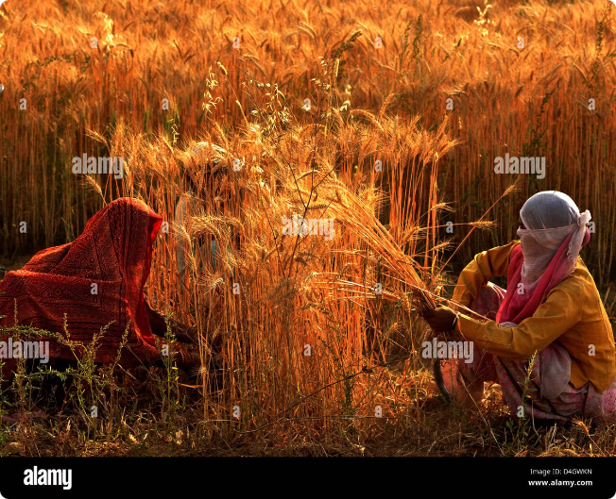
Key Trends in Crop Yields
1
Wheat
India is the world's second-largest wheat producer, with yields consistently increasing due to improved varieties and farming techniques.
2
Rice
Rice production is concentrated in the eastern and southern regions, with yields showing steady growth, driven by irrigation and advancements in seed technology.
3
Pulses
Pulse crops, including lentils and chickpeas, have seen a rise in production, attributed to government initiatives promoting their cultivation.

Slide 4
Regional Variations in Crop Production
Northern Plains
Eastern India
Southern India
This region is a major producer of wheat, rice, and sugarcane, benefiting from fertile soil and ample irrigation.
Known for its production of rice, jute, and tea, this region faces challenges due to heavy rainfall and susceptibility to floods.
This region boasts diverse crops, including rice, sugarcane, coffee, and spices, and is recognized for its high productivity.

Slide 5

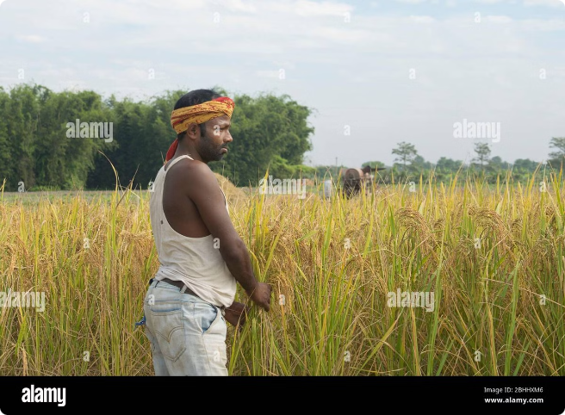
Challenges and Opportunities
1
Climate Change
Extreme weather events and changing rainfall patterns pose significant risks to crop production.
2
Water Scarcity
Competition for water resources is intensifying, demanding efficient irrigation practices and water conservation measures.
3
Market Volatility
Fluctuating commodity prices and market uncertainties present challenges for farmers in securing stable incomes.
4
Technological Adoption
Bridging the digital divide and empowering farmers with access to technology is crucial for unlocking the potential of modern agriculture.

Slide 6
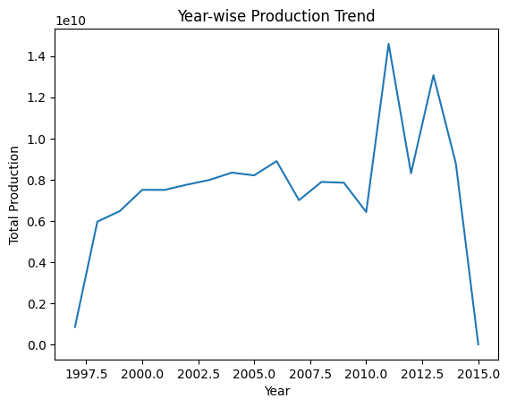
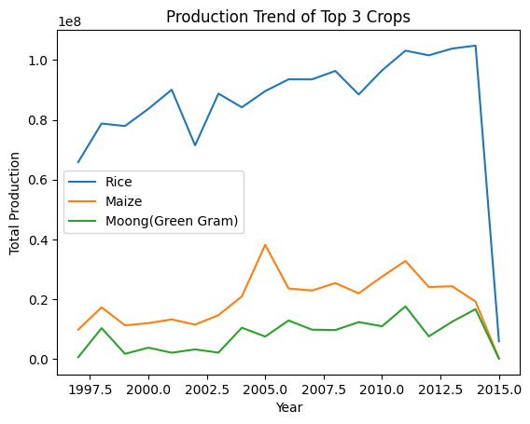
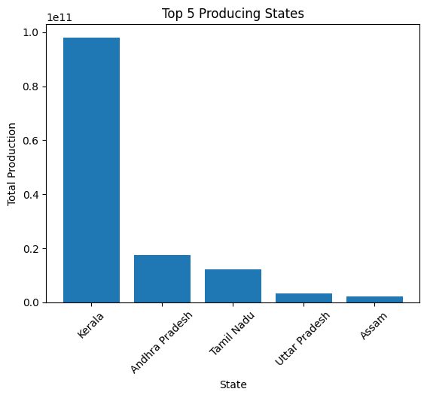
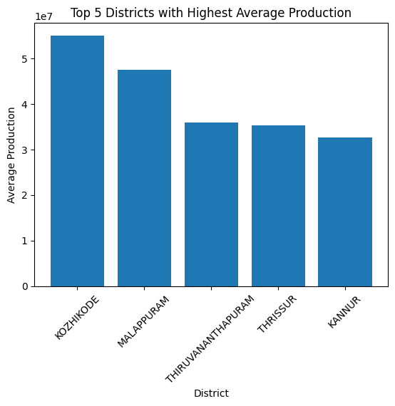
Output Dashboard

